Slide 1

Hardware and Mobile Devices
Pertemuan 3
Dr. Dedi Trisnawarman

Slide 2
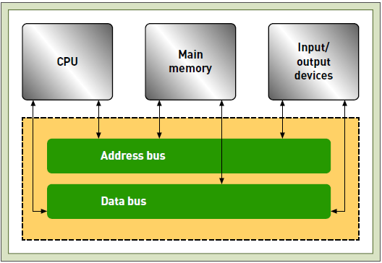
Basic Anatomy of A Computer
Computer hardware components include the processor (CPU), memory, address and data bus, and input/output devices

Slide 3
Processor
central processing unit (CPU): The part of a computer that sequences and executes instructions.
memory: A component of the com- puter that provides the processor with a working storage area to hold program instructions and data.
input/output device: A computer component that provides data and instructions to the computer and receives results from it.
bus: A set of electronic circuits used to route data and instructions to and from the various components of a computer

Slide 4
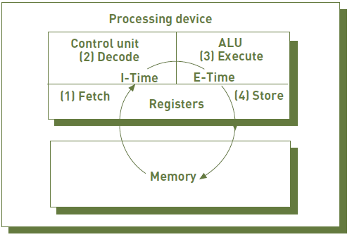
Execution of an instruction
(1)In the instruction phase, a program’s instructions and any necessary data are read into the processor.
(2) The instruction is then decoded by the control unit of the CPU so that the central processor can understand what to do.
(3) In the execution phase, the arithmetic and logic unit (ALU) component of the CPU does what it is instructed to do, making either an arithmetic computation or a logical comparison.
(4) The results are then stored in the registers or in memory. The instruction and execution phases together make up one machine cycle.

Slide 5
Instruction Set Architecture (ISA)
instruction set architecture (ISA): A basic set of commands (opcodes) that the processor can execute.
● ADD—Add two numbers together.
● COMPARE—Compare numbers.
● IN—Input information from a device (e.g., keyboard).
● JUMP—Jump to designated memory address.
● JUMP IF—Conditional statement that jumps to a designated memory
address.
● LOAD—Load information from memory to the processor.
● OUT—Output information to device (e.g., monitor).
● STORE—Store information to memory.
clock speed: A series of electronic pulses produced at a predetermined rate that affects machine cycle time.
gigahertz (GHz): A unit of frequency that is equal to one billion cycles per second; a measure of clock speed.

Slide 6
Multiprocessing
multiprocessing: The simultaneous execution of two or more instructions at the same time.
coprocessor: The part of the computer that speeds processing by executing specific types of instructions while the CPU works on another processing activity.
multicore processor: A microprocessor that has two or more independent processing units, called cores, which are capable of sequencing and executing instructions.

Slide 7
Parallel Computing
parallel computing: The simultaneous execution of the same task on multiple processors to obtain results faster.
massively parallel processing system: A system that speeds processing by linking hundreds or thousands of processors to operate at the same time, or in parallel, with each processor having its own bus, memory, disks, copy of the operating system, and applications.

Slide 8
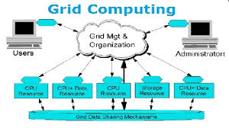
Grid Computing
The use of a collection of computers, often owned by multiple individuals or organizations, that work in a coordinated manner to solve a common problem.

Slide 9
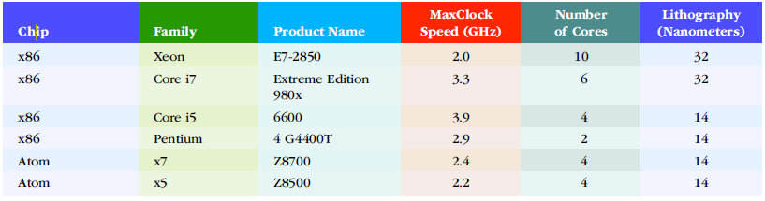
The Intel Family Of Processors

Slide 10
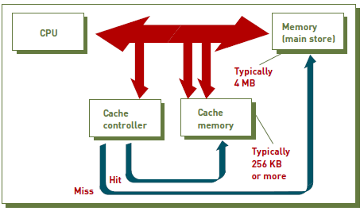
Memory
main memory: The component of a computer that provides the CPU with a working storage area for program instructions and data.
byte (B): Eight bits that together represent a single character of data.
random access memory (RAM): A form of memory in which instructions or data can be temporarily stored.
cache memory: A type of highspeed memory that a processor can access more rapidly than main memory.
read-only memory (ROM): A nonvolatile form of memory.

Slide 11
Secondary Storage
secondary storage: A device that stores large amounts of data, instructions, and information more permanently than allowed with main memory.
hard disk drive (HDD): A direct access storage device used to store and retrieve data from rapidly rotating disks coated with magnetic material.
Solid state storage device (SSD): A storage device that stores data in memory chips rather than on hard disk drives or optical media.

Slide 12
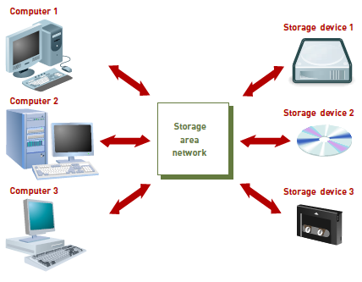
Enterprise Storage Options
network-attached storage (NAS): A hard disk drive storage device that is set up with its own network address and provides file-based storage services to other devices on the network.
storage area network (SAN): A high-speed, special-purpose network that integrates different types of data storage devices (e.g., hard disk drives, magnetic tape, solid state secondary storage devices) into a single storage system and connects that to computing resources across an entire organization.
storage as a service: A data storage model where a data storage service provider rents space to individuals and organizations.

Slide 13
Input and Output Devices
data entry: Converting humanreadable data into a machine-readable form.
data input: Transferring machinereadable data into the system.
source data automation: Capturing and editing data where it is initially created and in a form that can be directly entered into a computer, thus ensuring accuracy and timeliness.

Slide 14
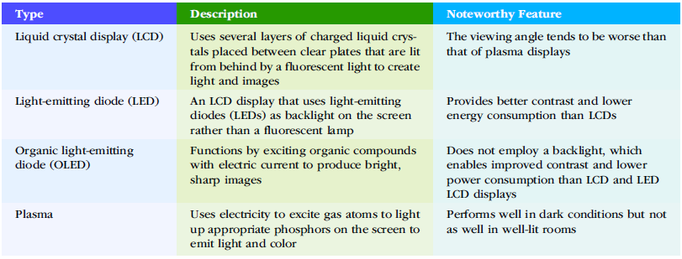
Various types of flat-panel displays

Slide 15
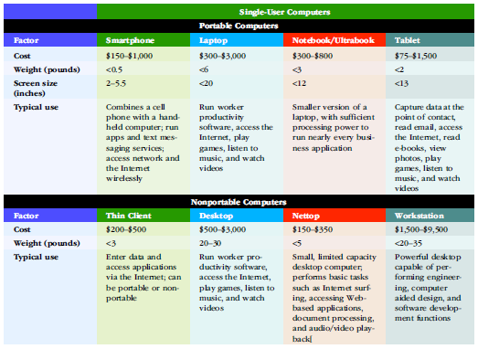
Single-user Computer Systems

Slide 16
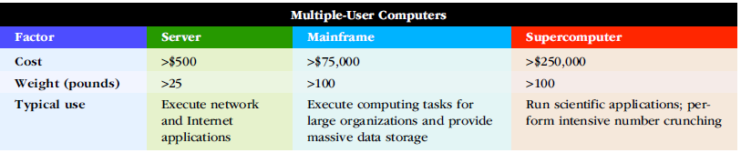
Multiple-User Computer Systems

Slide 17
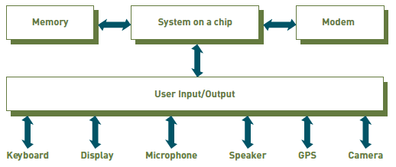
Anatomy of a smartphone
Smartphones employ a combination chipset called a “system on a chip,” which includes processor cores, RAM and ROM memory, interface controllers, and voltage regulators.

Slide 18
Thin Clients, Desktops, and Workstations
thin client: A low-cost, centrally managed computer with no internal or external attached drives for data storage.
desktop computer: A nonportable computer that fits on a desktop and provides sufficient computing power, memory, and storage for most business computing tasks.
nettop: A very small, inexpensive desktop computer typically used for Internet access, email, accessing Web-based applications, document processing, and audio/video playback.
workstations: A more powerful personal computer used for mathematical computing, computer-assisted design, and other high-end processing but still small enough to fit on a desktop.

Slide 19
Servers, Mainframes, and Supercomputers
server: A computer employed by many users to perform a specific task, such as running network or Internet applications.
scalability: The ability to increase the processing capability of a computer system so that it can handle more users, more data, or more transactions in a given period.
mainframe computer: A large, powerful computer often shared by hundreds of concurrent users connected to the machine over a network.
supercomputers: The most powerful computer systems with the fastest processing speeds.

Slide 20
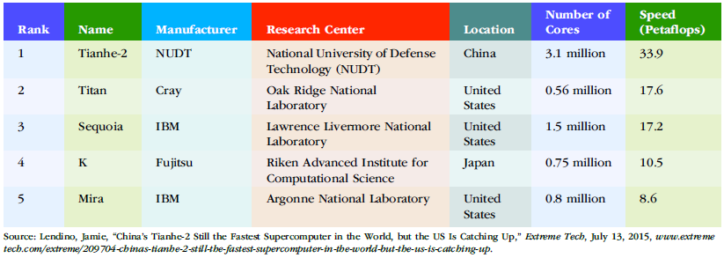
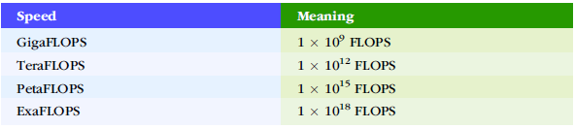
Supercomputer Processing Speeds

Slide 21
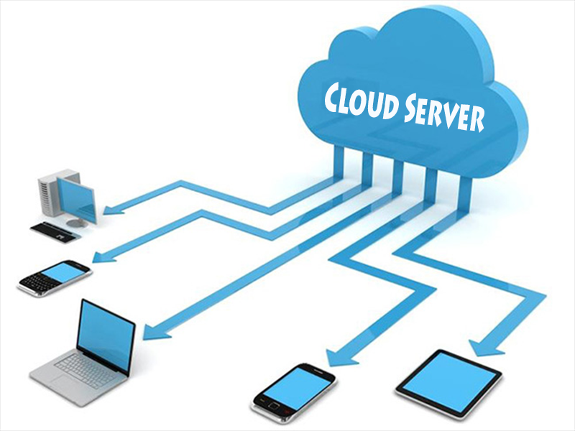
Cloud Server
virtual server: A method of logically dividing the resources of a single physical server to create multiple logical servers, each acting as its own dedicated machine.
A cloud server is a virtual server (rather than a physical server) running in a cloud computing environment. It is built, hosted and delivered via a cloud computing platform via the internet, and can be accessed remotely. They are also known as virtual servers.

Slide 22
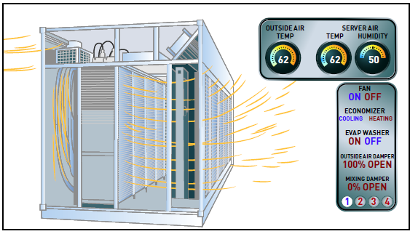
Data Center
data center: A climateand- access-controlled building or a set of buildings that houses the computer hardware that delivers an organization’s data and information services.

Slide 23

Green Computing
green computing: A program concerned with the efficient and environmentally responsible design, manufacture, operation, and disposal of IS-related products.
It is estimated that 51.9 million computers, 35.8 million monitors, and 33.6 million hard copy devices (printers, faxes, etc.)—representing a total of 1.3 million tons of waste—were disposed of in the United States in 2010

